Slide 1
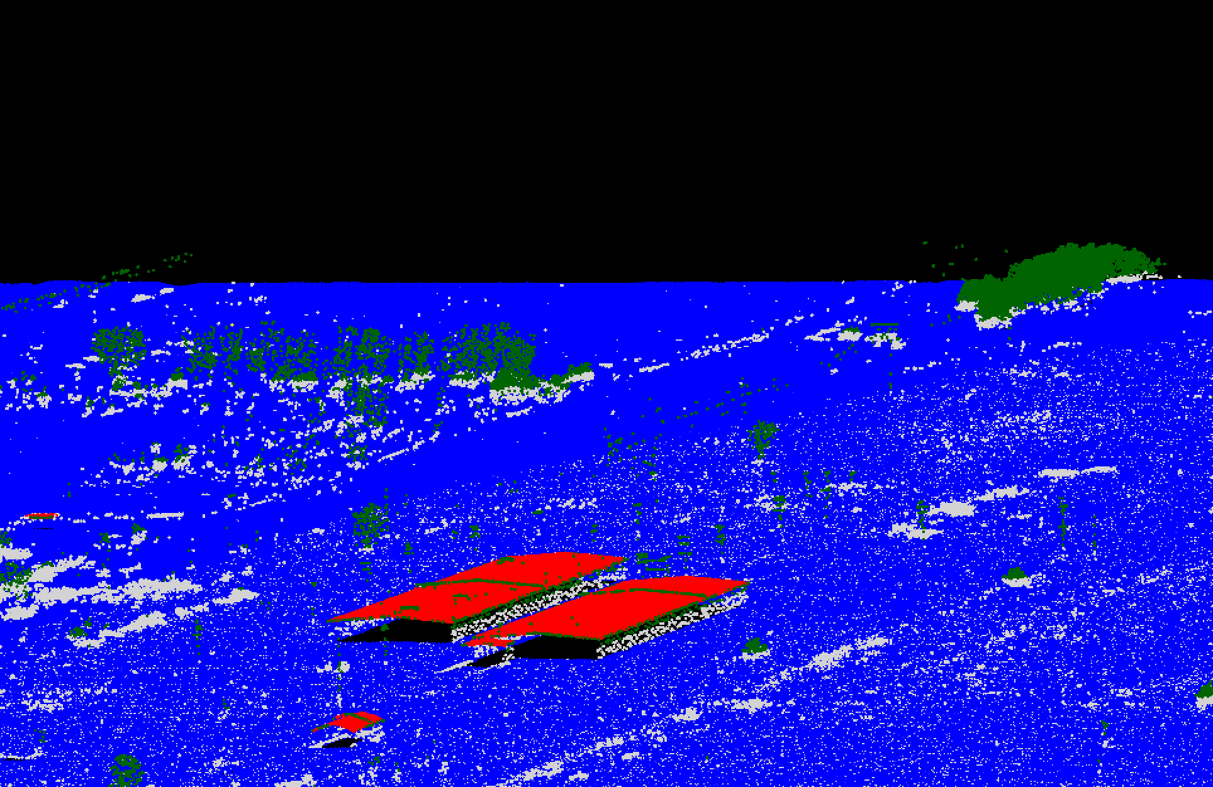
Lidar in R
Tutorial 1
2024 SciNet Fellows Conference
Kevin Li

Slide 2
Objectives
Learn about lidar
What is lidar?
Why would you want to use lidar data?
How can I get lidar data?
Learn about processing lidar data
What are common steps in processing lidar data?
Use the lidR package in R to process a lidar dataset

Slide 3
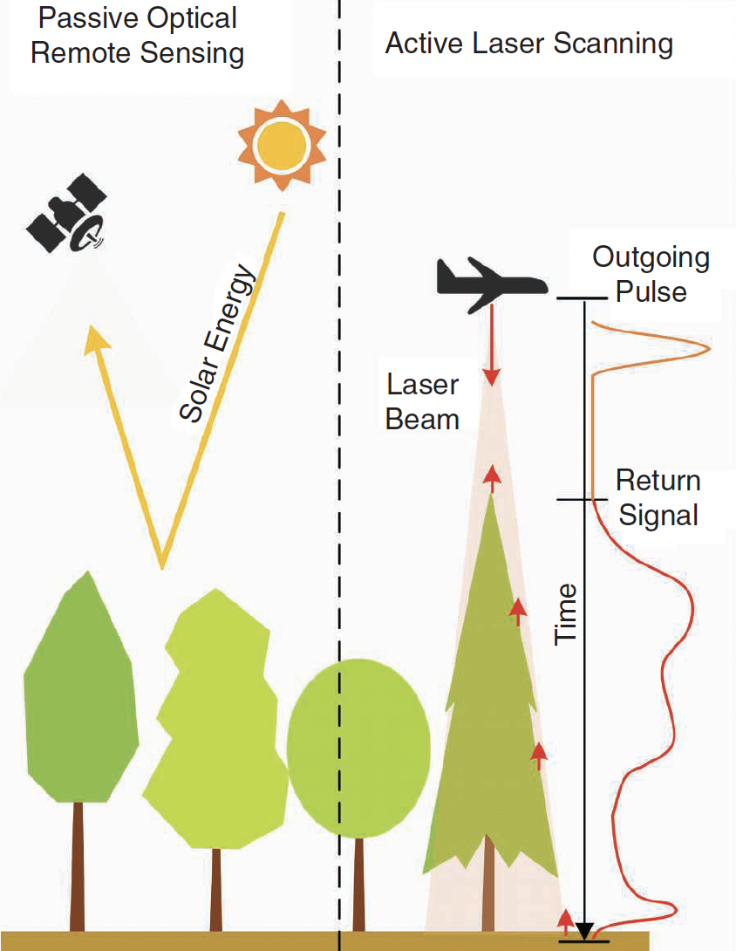
What is lidar?
Light Detection And Ranging
Active remote sensing
Measure distance of objects from sensor using laser pulses
Distance is measured by time difference
Guo et al. 2021
Notes:
- contrasts with passive remote sensing, which uses reflectance of solar energy
- lidar actively emits the energy it measures by sending pulses of laser light and using this to measure the distance of objects from the sensor
- The distance is measure through the time it takes for the emitted pulse to be received back by the sensor
- the distance from objects to the sensor is calculated by knowing the precise location of the sensor and and geometries of the pulse path

Slide 4
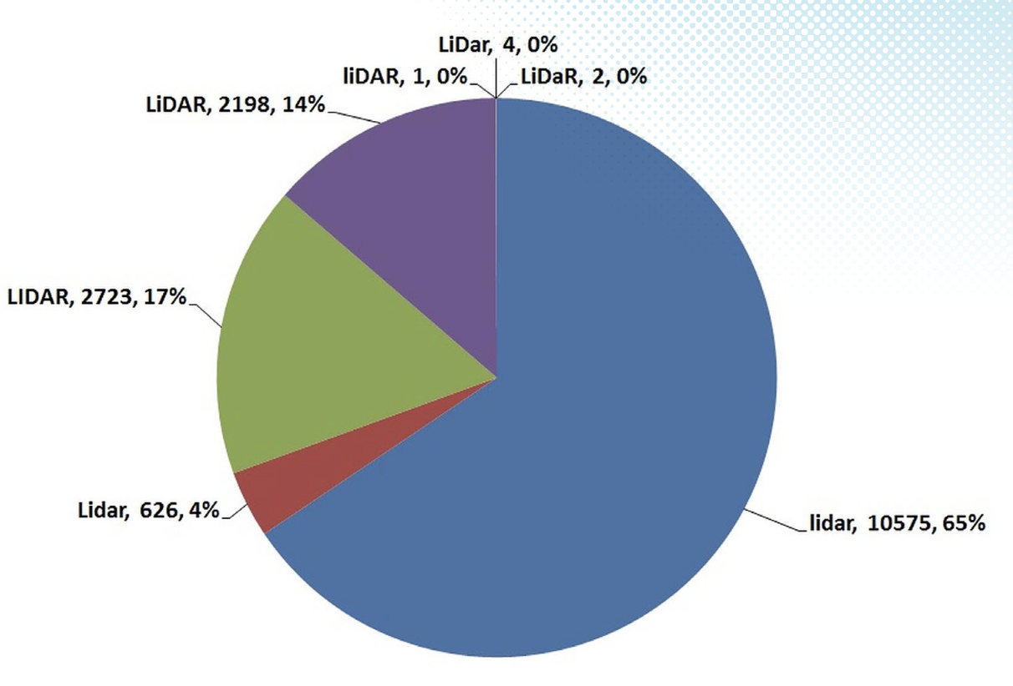
Is it LiDaR or lidar?
Deering, C., & Stoker, J. M. (2014). Let’s agree on the casing of Lidar. LiDAR Magazine, 4(6), 48–51.
“sonar” - 98%
“radar” – 99%
lidar
Notes:
- Deering and Stoker looked at this question in 2014 in lidar magazine
- They found some disagreement in the peer reviewed literature but about 2/3 of articles use all lower case lidar
- contrast this with ‘sonar’ – sound navigation and ranging
- and with ‘radar’ – radio detection and ranging

Slide 5
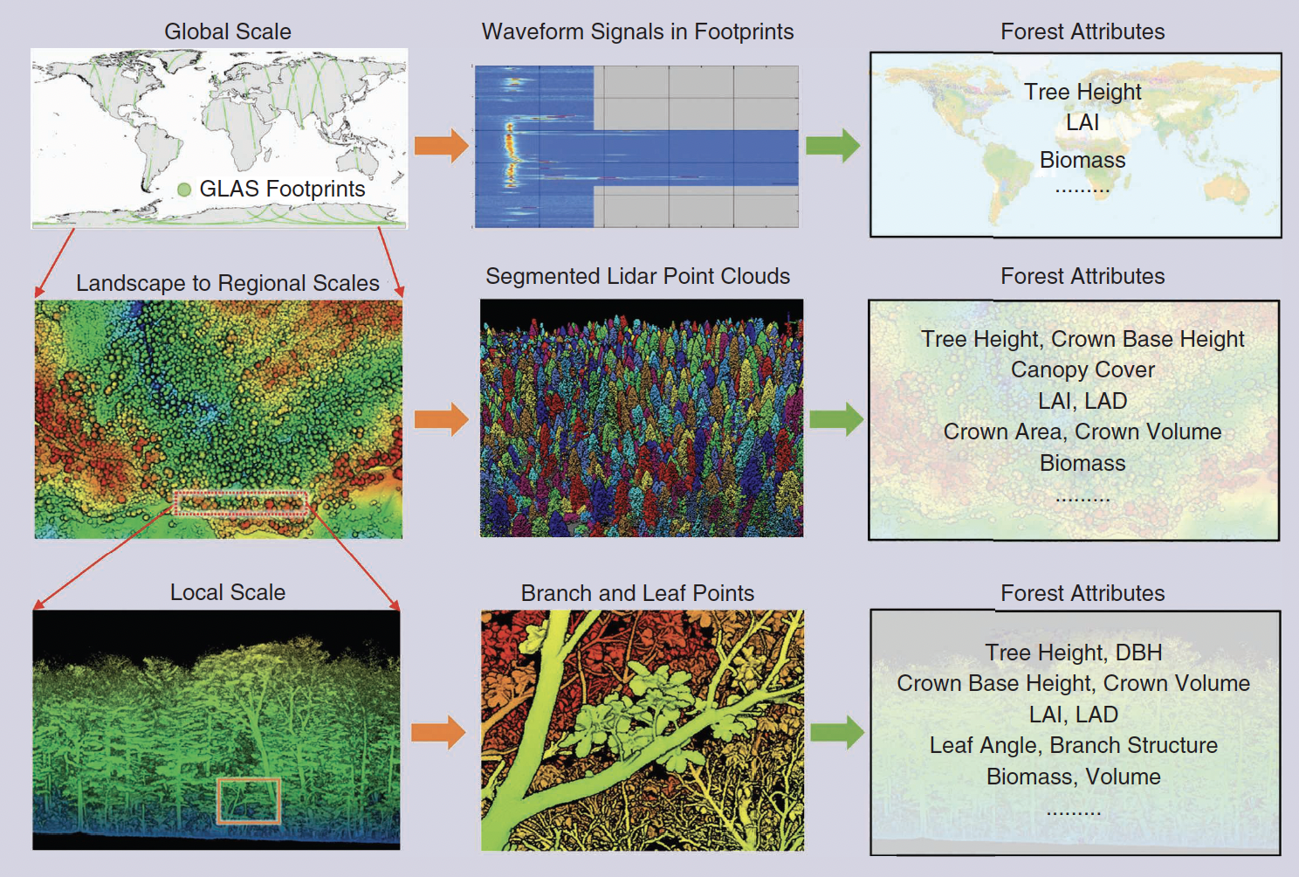
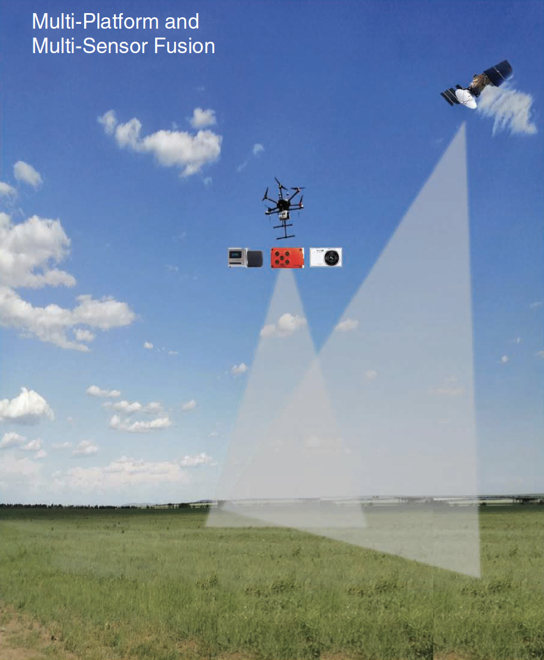
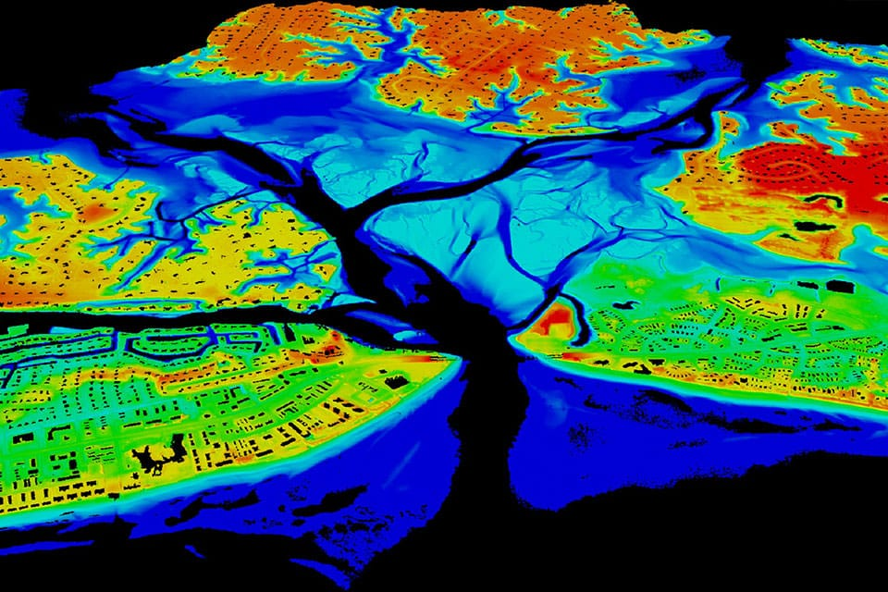
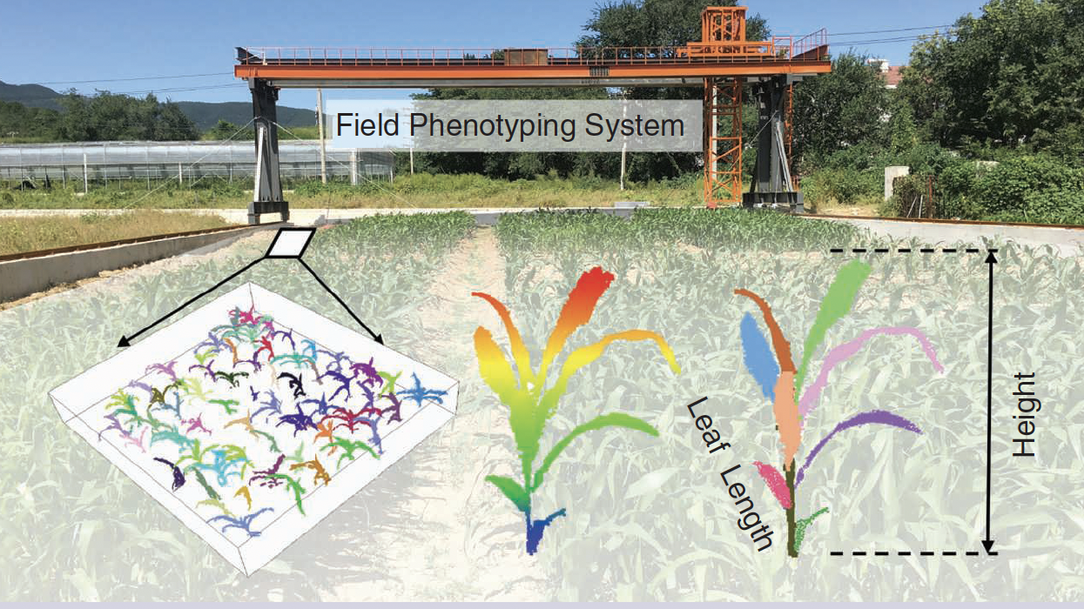
Why lidar?
https://oceanservice.noaa.gov/facts/lidar.html
Zhou et al. 2022
Notes:
Detailed terrain models and bathymetric (underwater terrain) lidar with water-penetrating green light
Vegetation volume and biomass estimation at multiple scales, from global scale (spaceborne lidar); landscape scale to look at forest attributes; local scale to look at vegetation structure
Can be used for agricultural ecosystems, monitoring crop growth, crop phenotyping in a nondestructive way
- recognize individual plant parts using deep learning techniques
Data fusion possibilities – combining lidar data with other remote sensing data to integrate structural info from lidar and spectral info from spaceborne remote sensors
https://oceanservice.noaa.gov/facts/lidar.html
Zhou, L., Li, X., Zhang, B., Xuan, J., Gong, Y., Tan, C., Huang, H., & Du, H. (2022). Estimating 3D Green Volume and Aboveground Biomass of Urban Forest Trees by UAV-Lidar. Remote Sensing, 14(20), 5211. https://doi.org/10.3390/rs14205211

Slide 6
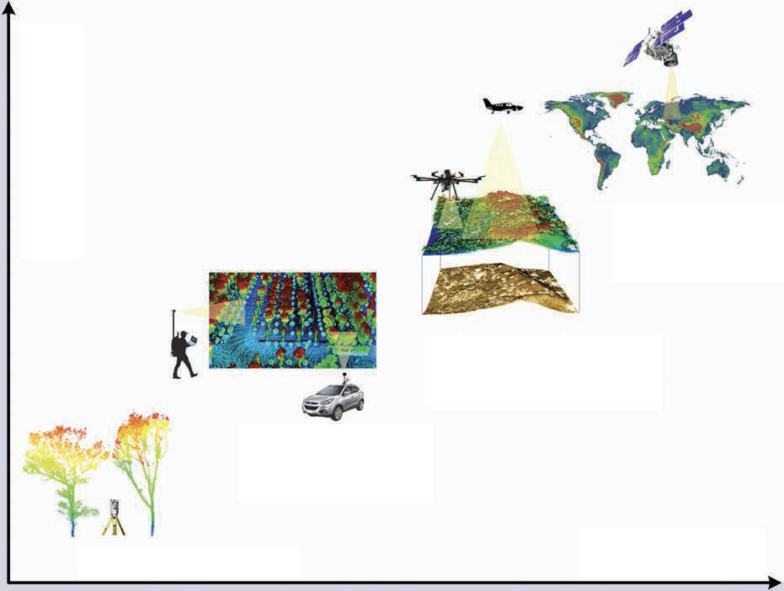
How can I get lidar data?
Large
Spaceborne lidar
Spatial Extent
UAV and airborne lidar
Backpack and mobile lidar
Small
Terrestrial lidar
High
Resolution
Low
Adapted from Guo et al. 2023
Notes:
- lidar data can be collected over multiple scales, different technologies
- this affects the resolution of the data produced and the spatial extent that can be effectively covered
- we will be working with UAV and airborne collected lidar

Slide 7
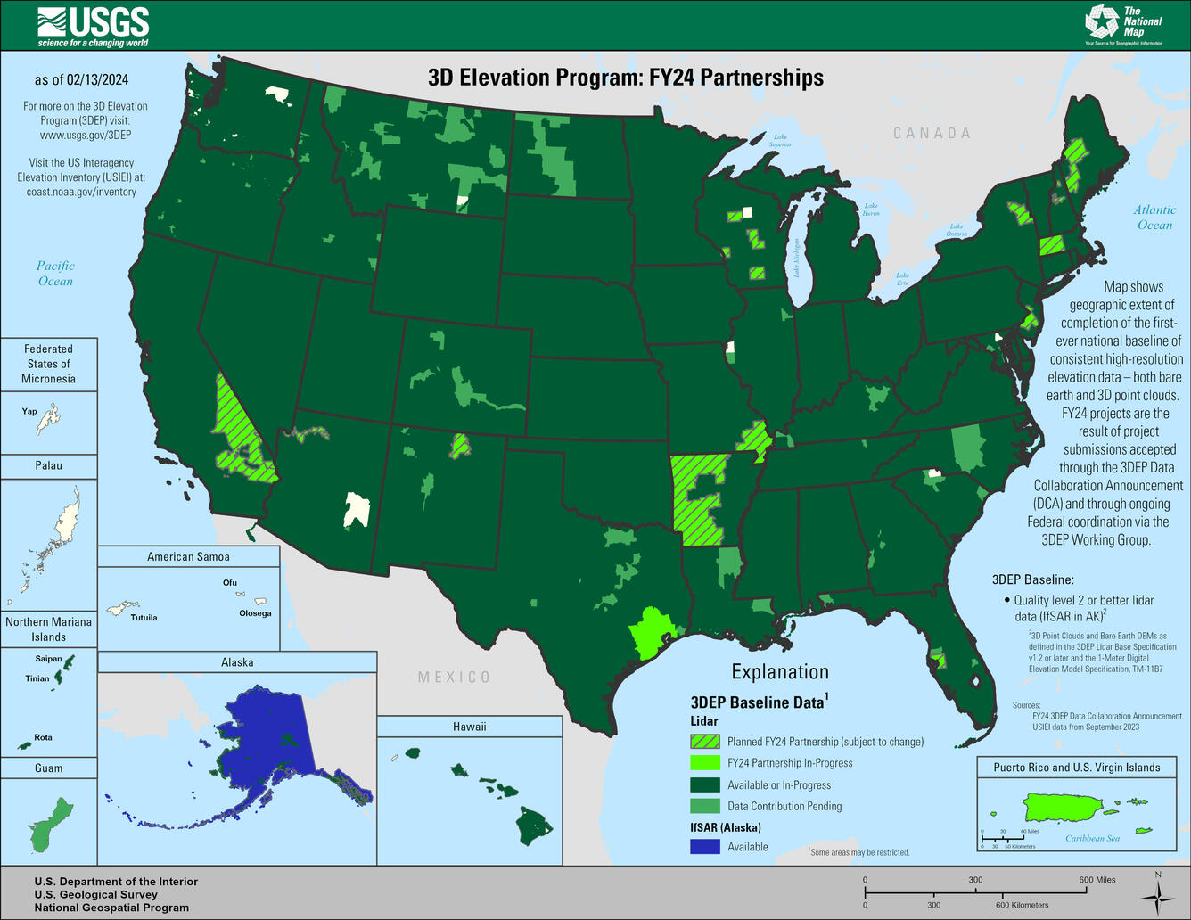
National 3D Elevation Program
Nationwide lidar data
Bare earth and 3D point clouds
https://apps.nationalmap.gov/lidar-explorer/#/
https://www.usgs.gov/3d-elevation-program

Slide 8
Objectives
Learn about lidar
What is lidar?
Why would you want to use lidar data?
How can I get lidar data?
Learn about processing lidar data
What are common steps in processing lidar data?
Use the lidR package in R to process a lidar dataset

Slide 9
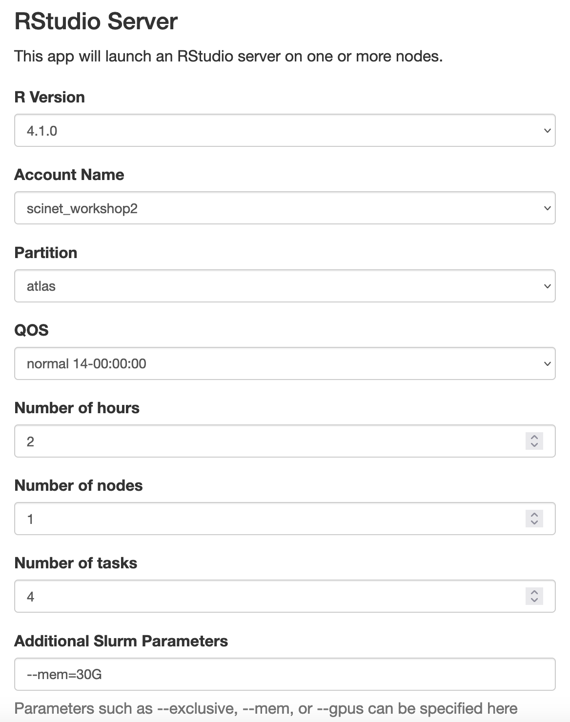
https://atlas-ood.hpc.msstate.edu/
In Rstudio, click terminal tab and type:
mkdir –p /90daydata/shared/$USER/tutorial1_lidr/
Make your own tutorial1 folder
cd /90daydata/shared/$USER/tutorial1_lidr/
Go into your new folder
cp -r /project/scinet_workshop2/tutorial1/. .
Move tutorial data into your folder
ln -s "$(pwd)" ~
Create a symbolic link to the new folder in your home dir
GitHub Repository:
https://github.com/KevinLi-USDA/lidar_tutorial

Slide 10
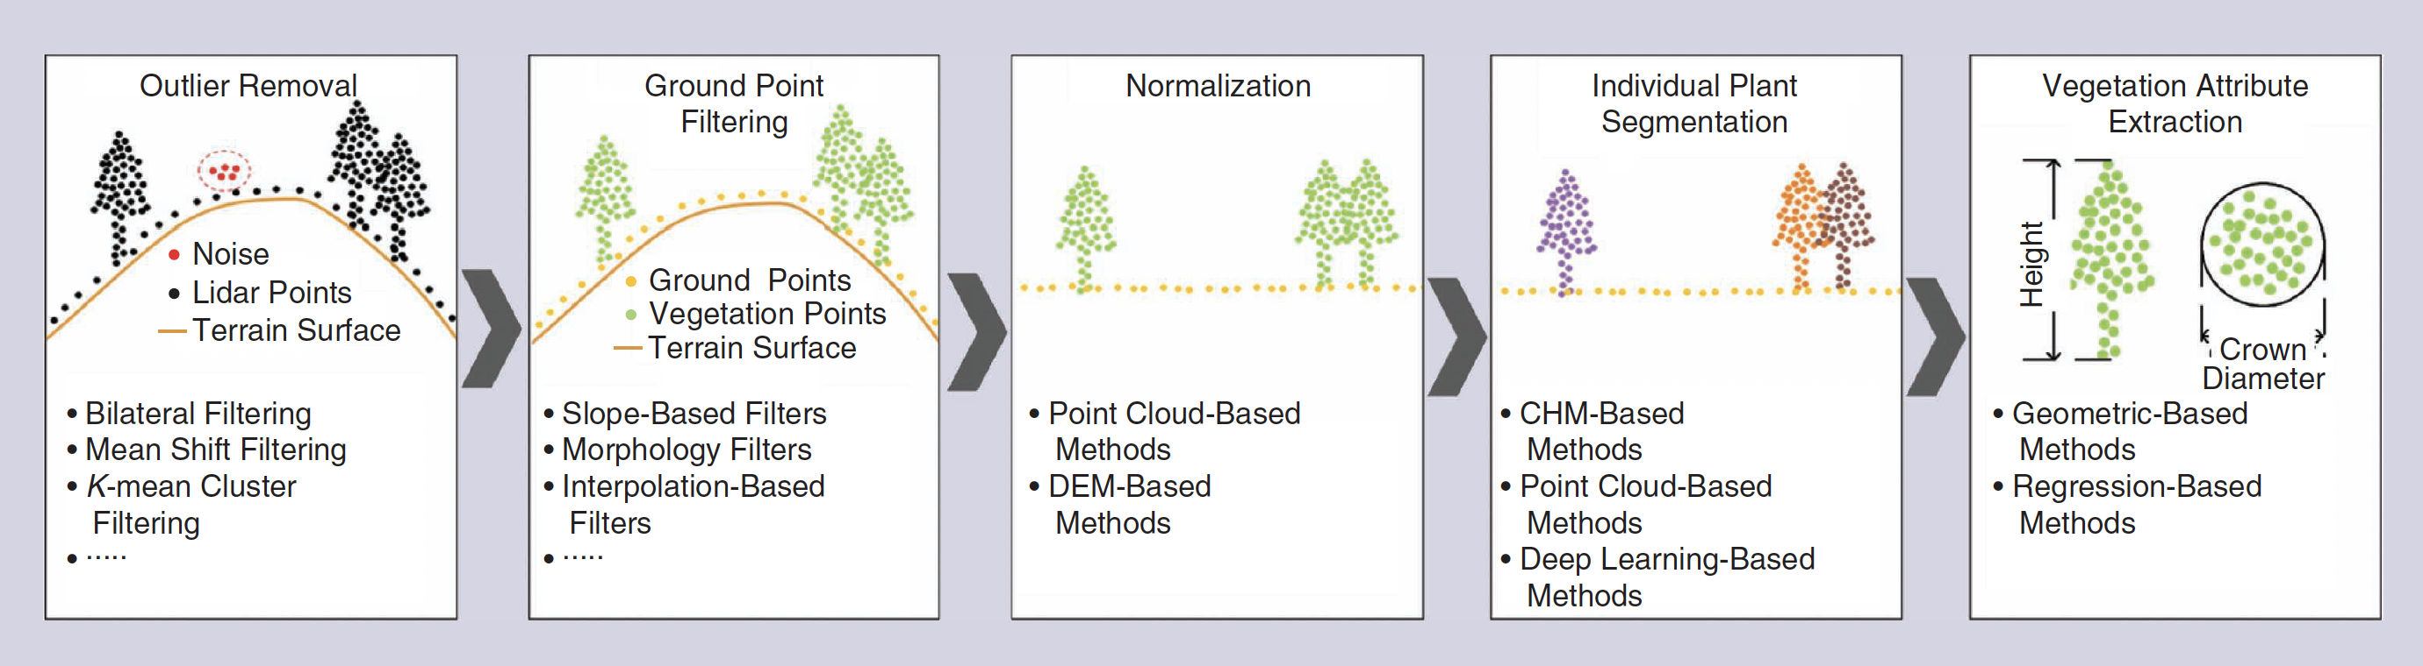
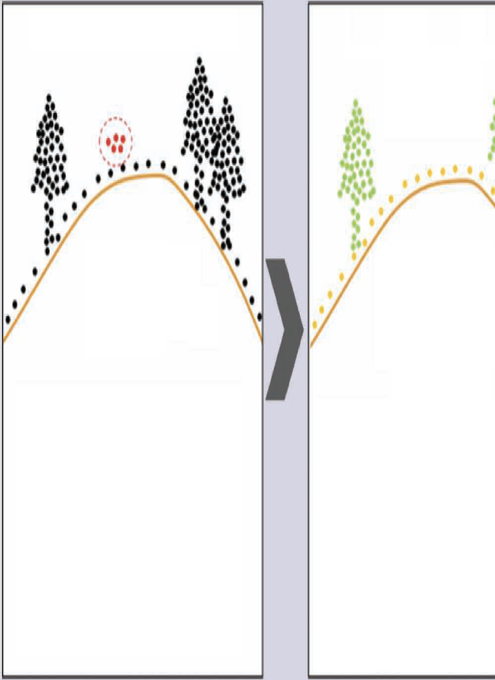
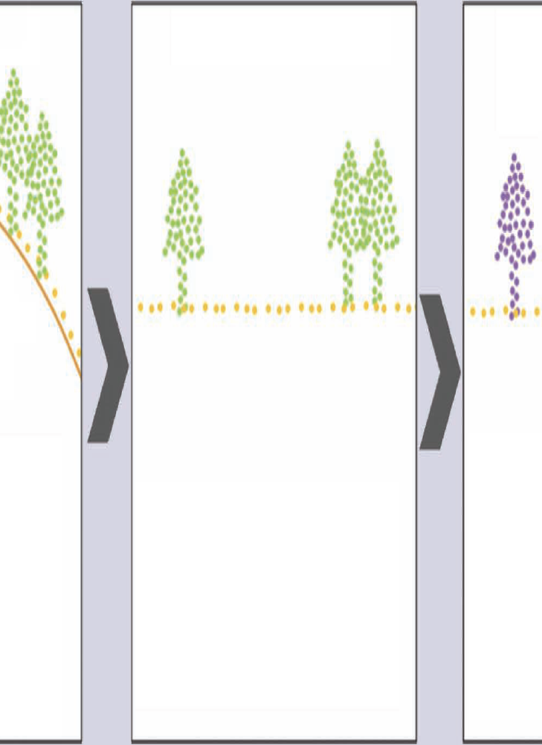
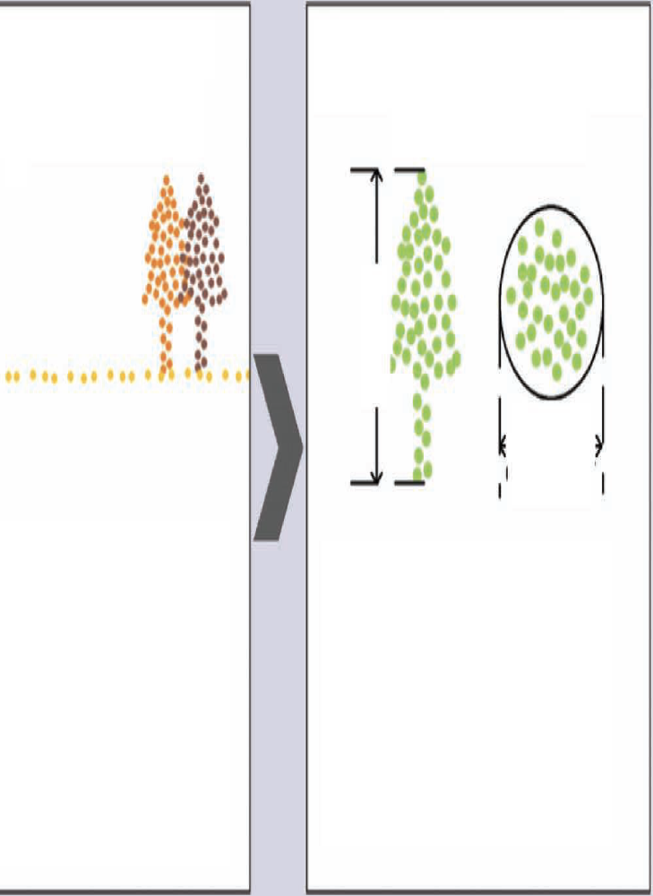


Common steps in processing lidar
Guo et al. 2021
Ground Point Filtering
Individual Plant Segmentation
Vegetation Attribute Extraction
Outlier removal
Normalization

Slide 11
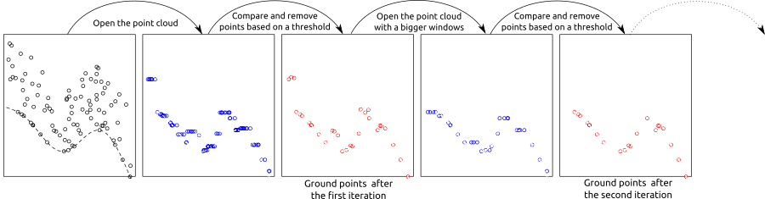
Progressive morphological filtering
Roussel et al. 2023

Slide 12
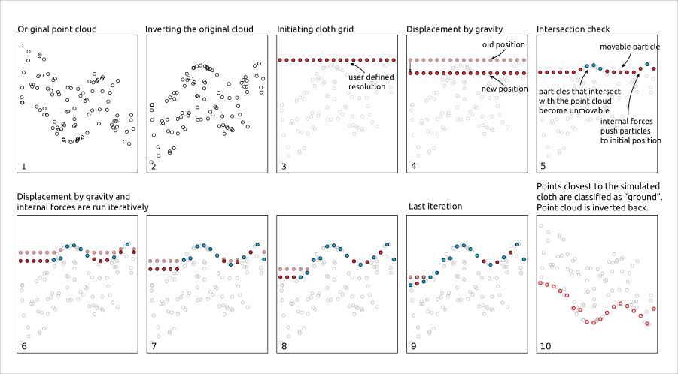
Cloth simulation filter
Roussel et al. 2023

Slide 13
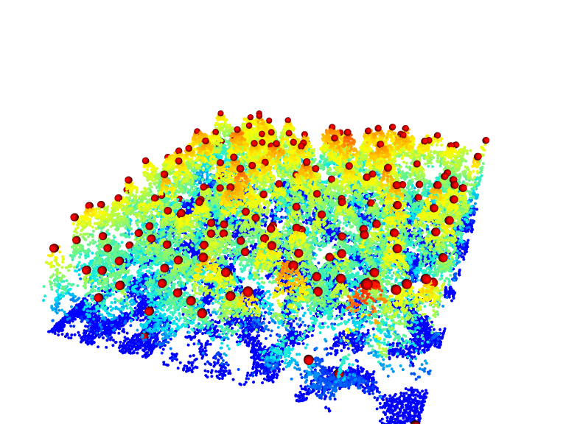
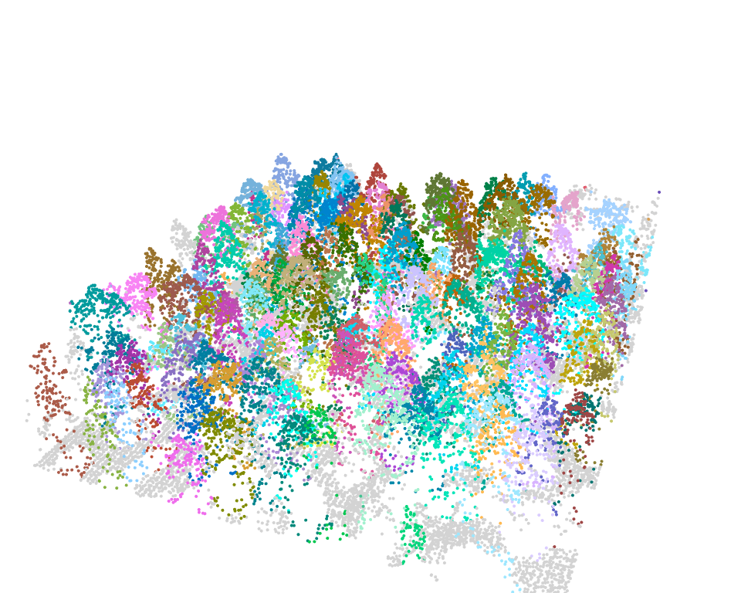
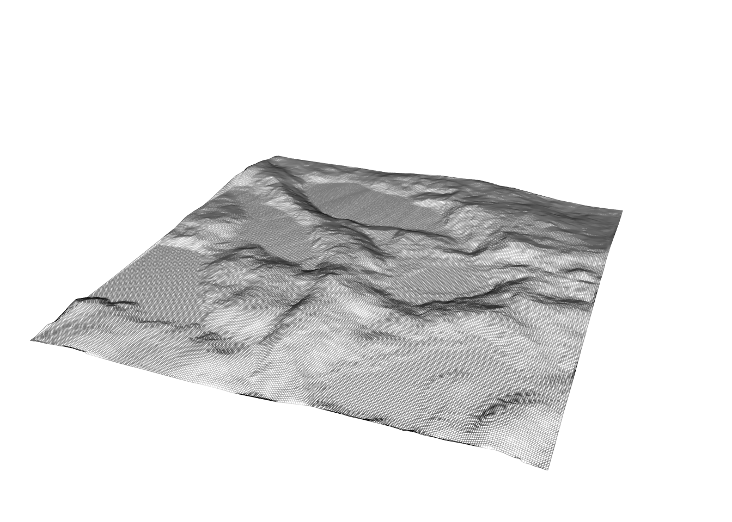
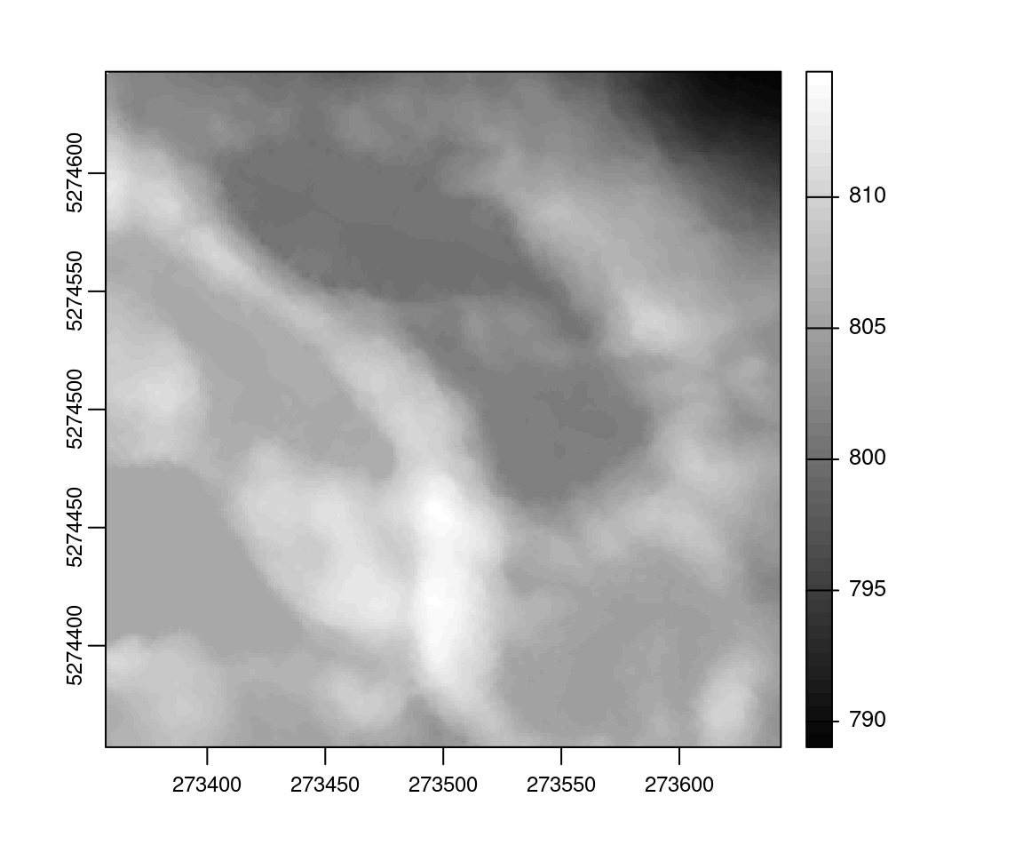
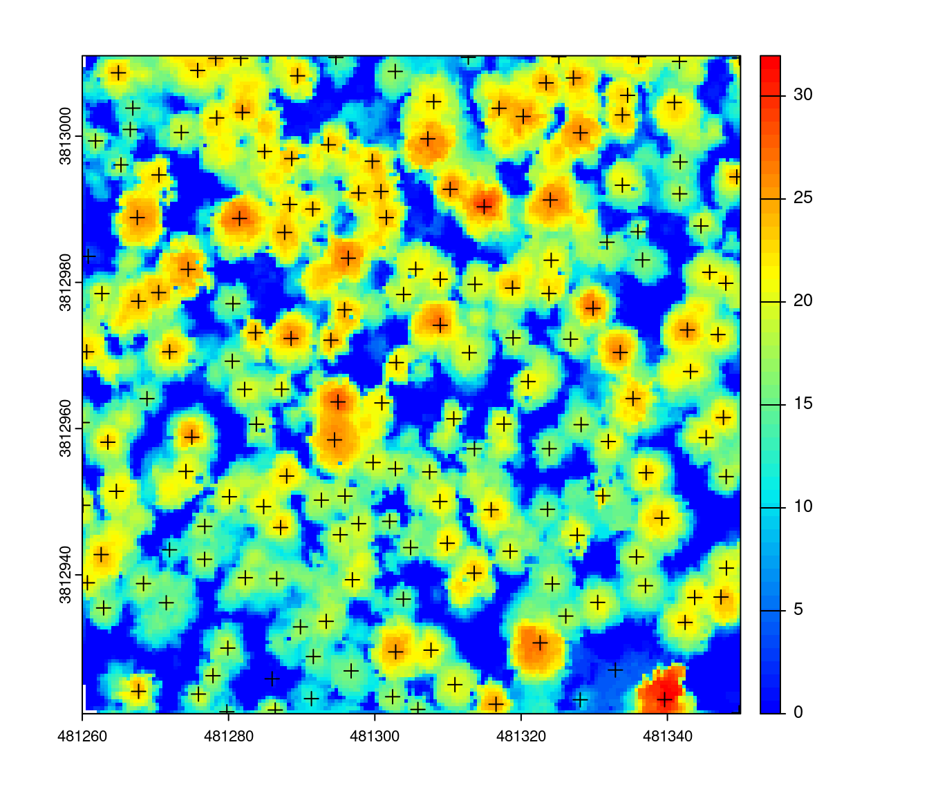
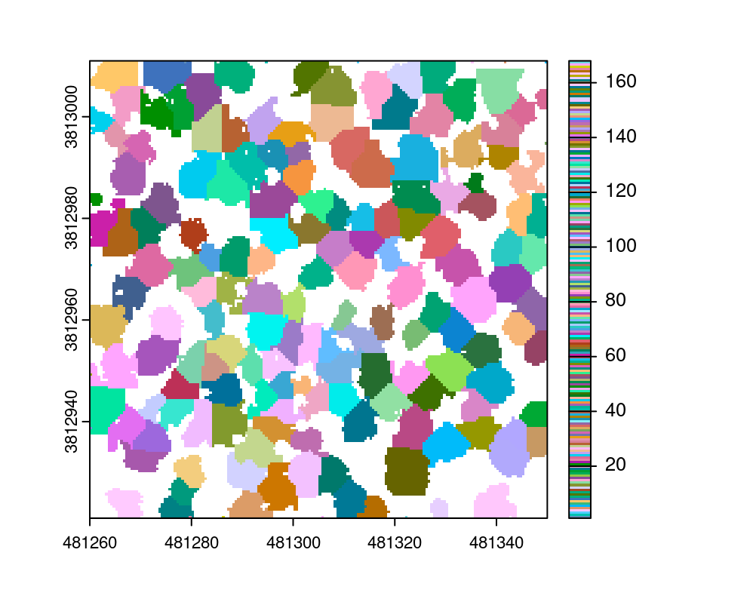
Visualizing lidR outputs in R
Roussel et al. 2023

Slide 14
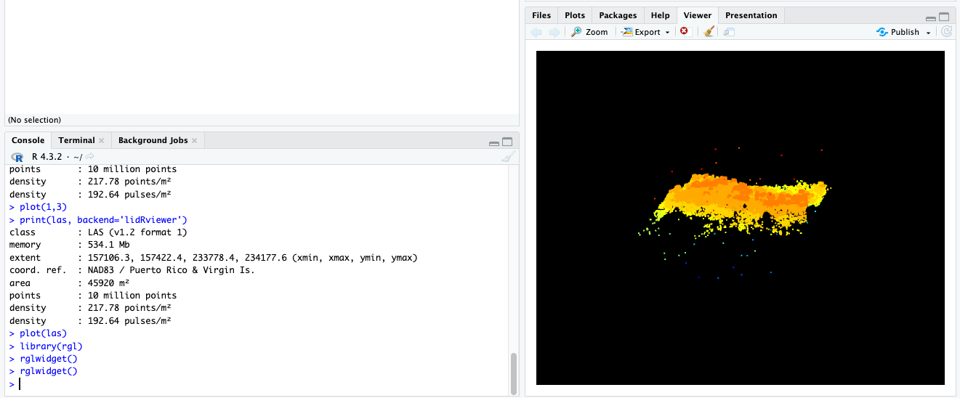

Slide 15
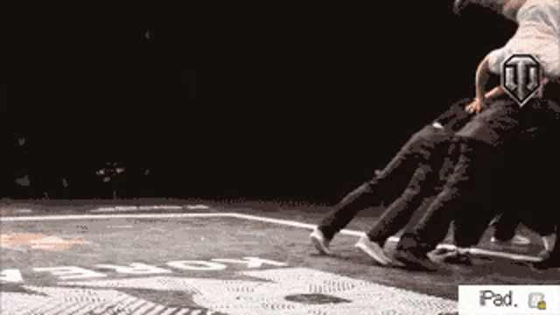
Using parallel processing in lidR

Slide 16
References
Q. Guo et al., "Lidar Boosts 3D Ecological Observations and Modelings: A Review and Perspective," in IEEE Geoscience and Remote Sensing Magazine, vol. 9, no. 1, pp. 232-257, March 2021, doi: 10.1109/MGRS.2020.3032713.
Roussel, J.-R., Goodbody, T. R. H., & Tompalski, P. (2023). The lidR package. https://r-lidar.github.io/lidRbook/

